Slide 1
Artificial Bee Colony Algorithm

Slide 2
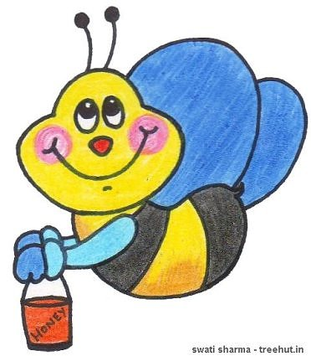
In The Name Of God
Artificial Bee Colony

Slide 3

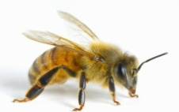

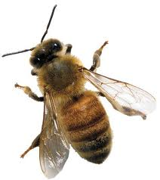
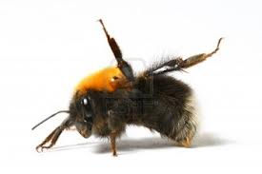
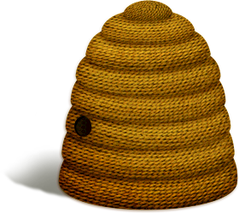
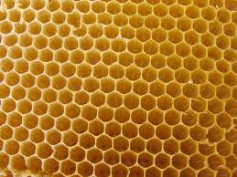
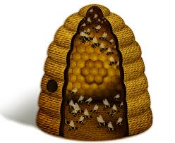
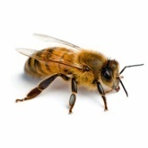
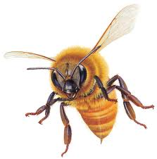
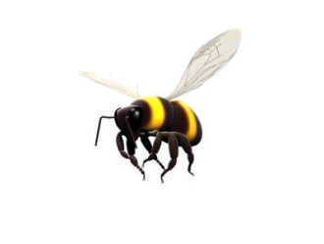

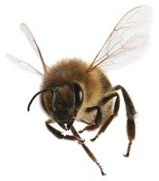
Artificial Bee Colony
Behaviour of Bees in Nature
Scout Bee (SB): If the bee starts searching spontaneously without any knowledge,
it will be a scout bee
Employed foragers (EF): When the recruit bee finds and exploits the food source, it will raise to be an employed forager who memorizes the location of the food source.
Food sources: the value of a food source depends on many factors. For the simplicity, the ‘‘proﬁtability’’ of a food source can be represented with a single quantity
Experienced foragers: These types of forager use their historical memories for the location and quality of food sources.
onlooker bees (OB): If the unemployed forager attends to a waggle dance done by some other bee, the bee will start searching by using the knowledge from waggle dance.
ES
EF
It can be a reactivated forager by using the information from waggle dance (RF)
It can be scout bee to search new patches if the whole food source is exhausted (ES).
It can be a recruit bee which is searching a new food source declared in dancing area by
another employed bee (ER)
RF
After the employed foraging bee loads a portion of nectar from the food source, it returns to the hive and unloads the nectar to the food area in the hive
ER
Dancing area for B
Unloading nectar from B
RF
Dancing aea for A
ER
OB
Unloading nectar from A
OB
ES
SB
EF

Slide 4
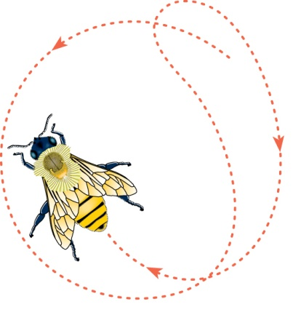
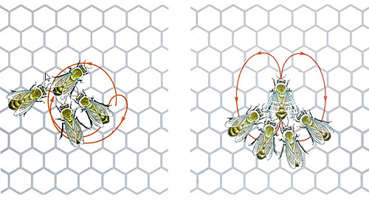
Artificial Bee Colony
Behaviour of Bees in Nature
Communication among bees about the quality of food sources is being achieved in the dancing area by performing waggle dance
While performing the waggle dance, the direction of bees indicates the direction of the food source in relation to the Sun, the intensity of the waggles indicates how far away it is and the duration of
the dance indicates the amount of nectar on
related food source.
Dancing aea for A

Slide 5
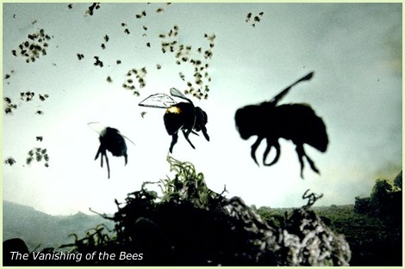
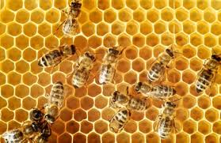
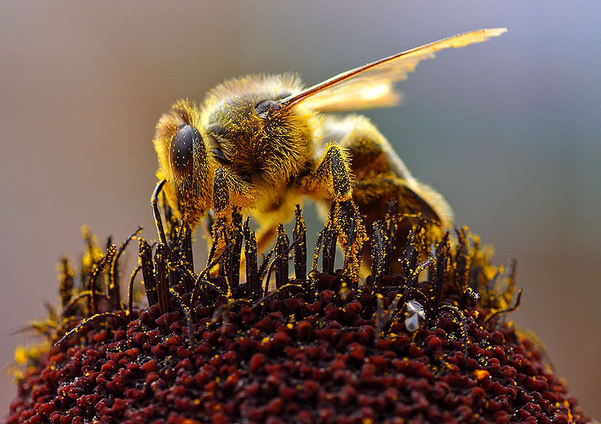
Artificial Bee Colony
Methodology
Artificial bee colony (ABC) algorithm was first proposed by Karaboga in 2005, which is based on a particular intelligent behavior of honeybee swarms
ABC algorithm is inspired by the foraging behavior of real bee colony. The objective of a bee colony is to maximize the nectar amount stored in the hive.
Each bee performs one of following three kinds of roles. They could transform from one role to another
in different phases of foraging
employed bees (EB)
onlooker bees (OB)
scout bees(SB)

Slide 6
Artificial Bee Colony
Methodology
The flow of nectar collection is as follow :
1.In initial phase, there are only some SB and OB in the colony. SB are sent out to search for potential nectar source, and OB wait near the hive for being recruited. If any SB finds a nectar source, it will transform into EB.
2. EB collect some nectar and go back to the hive, and then dance with different forms to share information of the source with OB. Diverse forms of dance represent different quality of nectar source.
3. Each OB estimates quality of the nectar sources found by all EB, then follows one of EB to the corresponding source. All OB choose EB according to some probability. Better sources (more nectar) are more attractive (with larger probability to be selected) to OB.
4. Once any sources are exhausted, the corresponding EB will abandon them, transform into SB and search for new source

Slide 7
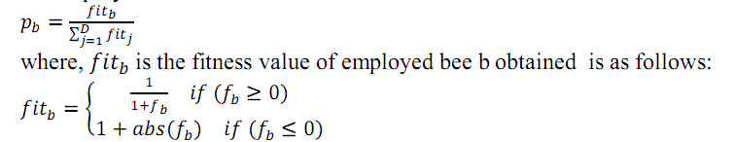



Artificial Bee Colony
Flowchart of ABC algorithm
1.Population Number (PN)
2. SB Triggering Threshold (Limit)
3.Maximum Cycle Number (MCN)
4.Dimention of Vector to Be Optimized (D)
5.Upper Bound (UB) & Lower Bound(LB) of Each Element
6.Ideal Fitness Threshold (IFT)
Parameters
Initialization
Scout Bee Phase
Randomly Generate a new Solution by (1)
For i=1:PN/2
Randomly Select Another Solution k Found by Other EB
Randomly Pick an Element j to be Modified
Modification Each Solution
Fitness Estimation before and after Modification: Fitness(x),Fitness(v)
According to Greedy Selection, Solution with better Fitness is reserved
If Solution does not Improve, Failure(i)=Failure(i)+1, otherwise Failure(i)=0
End
Yes
PN/2 Become Employed Bees, Other PN/2 Become Onlooker Bees
All the PN/2 EB Find PN/2 Nectar Source
Fitness Estimation of Each Source: Fitness(i)
Failure Counter of Each Source: Failure(i)=0
Bee Colony
Initialization
No
‘roulette wheel’ selection mechanism:
t=0; i=1;
While (t<PN/2)
If rand<prob(i)
t=t+1
Fllowing Step 1- 6 Employed Bee Phase, Modify the ith Solution.
End
i=i+1
End
Cycle = Cycle + 1
Failure(i) > Limit
Cycle
Start
No
Optimization
Complete
Yes
Has reached MCN?
Or
Ideal solution is found ?
Prob(i) = Fitness(i) / sum(Fitness)
Employed Bee
Phase
Estimate Recruiting
Probability
Onlooker Bee
Phase
Record Best
Solution

Slide 8
Artificial Bee Colony Algorithm
ABC is developed based on inspecting
the behaviors of real bees on finding nectar and
sharing the information of food sources to the bees in the hive
Three types of bee in ABC
The Employed Bee
The Onlooker Bee
The Scout

Slide 9
5.2 Agents in ABC
The Employed Bee: It stays on a food source and provides the neighborhood of the source in its memory.
The Onlooker Bee: It gets the information of food sources from the employed bees in the hive and select one of the food source to gathers the nectar.
The Scout: It is responsible for finding new food, the new nectar, sources

Slide 10
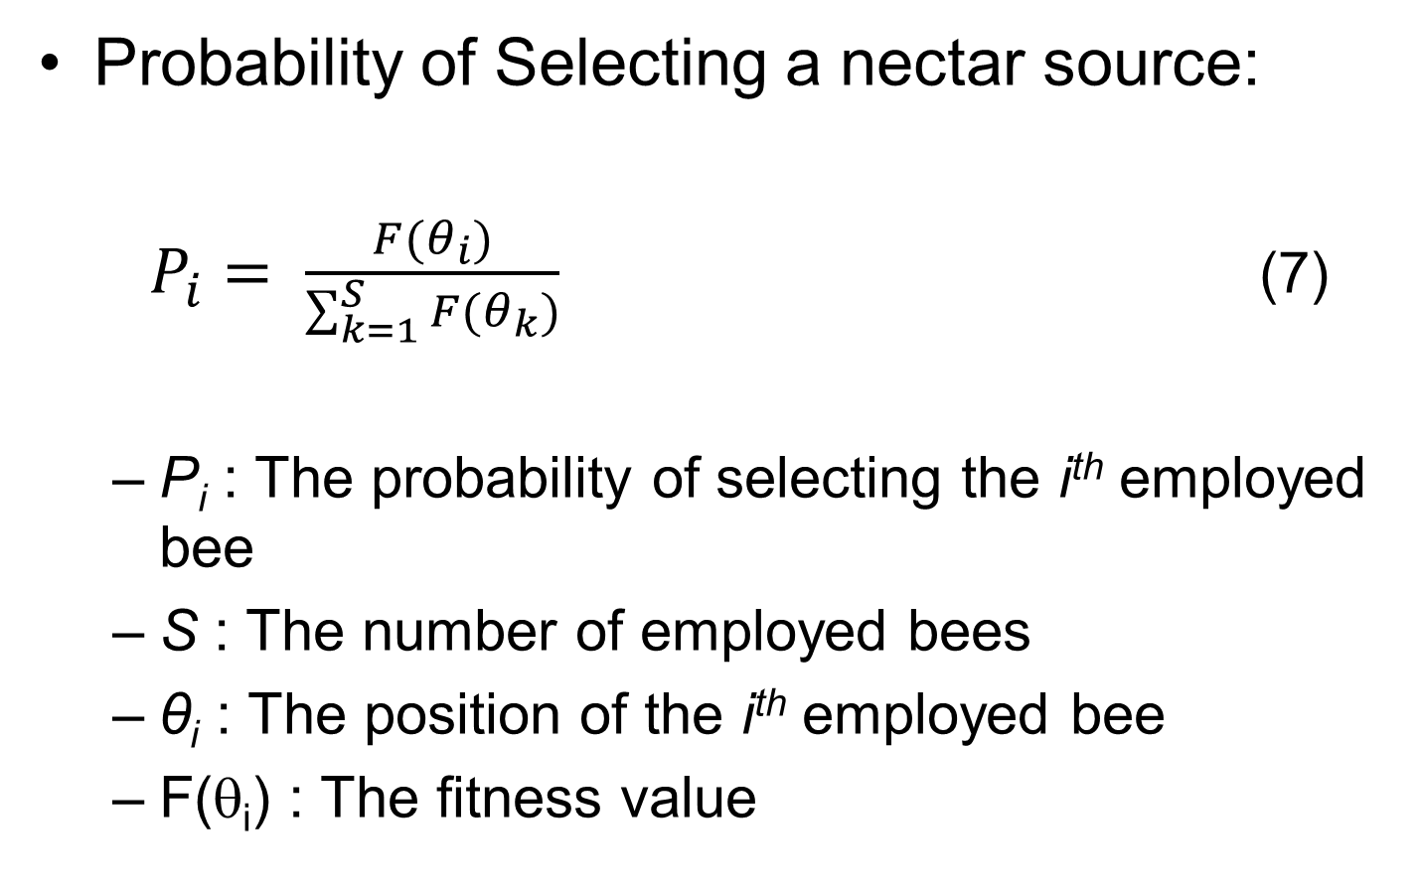
5.2 Movement of the Onlookers
Probability of Selecting a nectar source:
$P_{i}= \frac{F(θ_{i})}{\sum_{k=1}^{S}{F(θ_{k})}}$ (7)
P_{i} : The probability of selecting the i^{th} employed bee
S : The number of employed bees
θ_{i} : The position of the i^{th} employed bee
F(θ_{i}) : The fitness value

Slide 11
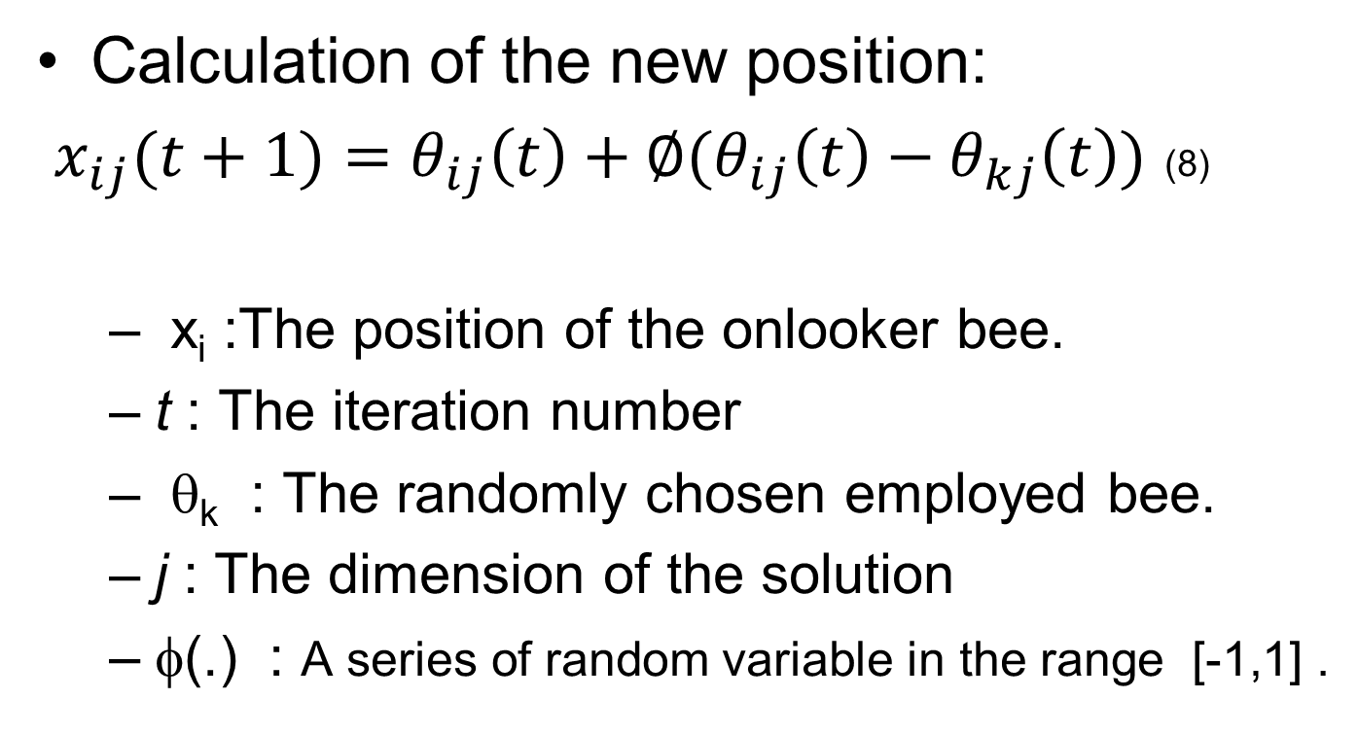
5.2 Movement of the Onlookers (2)
Calculation of the new position:
$x_{ij}(t+1)=θ_{ij}\left(t\right)+∅(θ_{ij}\left(t\right)−θ_{kj}\left(t\right))$ (8)
x_{i} :The position of the onlooker bee.
t : The iteration number
θ_{k} : The randomly chosen employed bee.
j : The dimension of the solution
φ(.) : A series of random variable in the range [-1,1] .

Slide 12
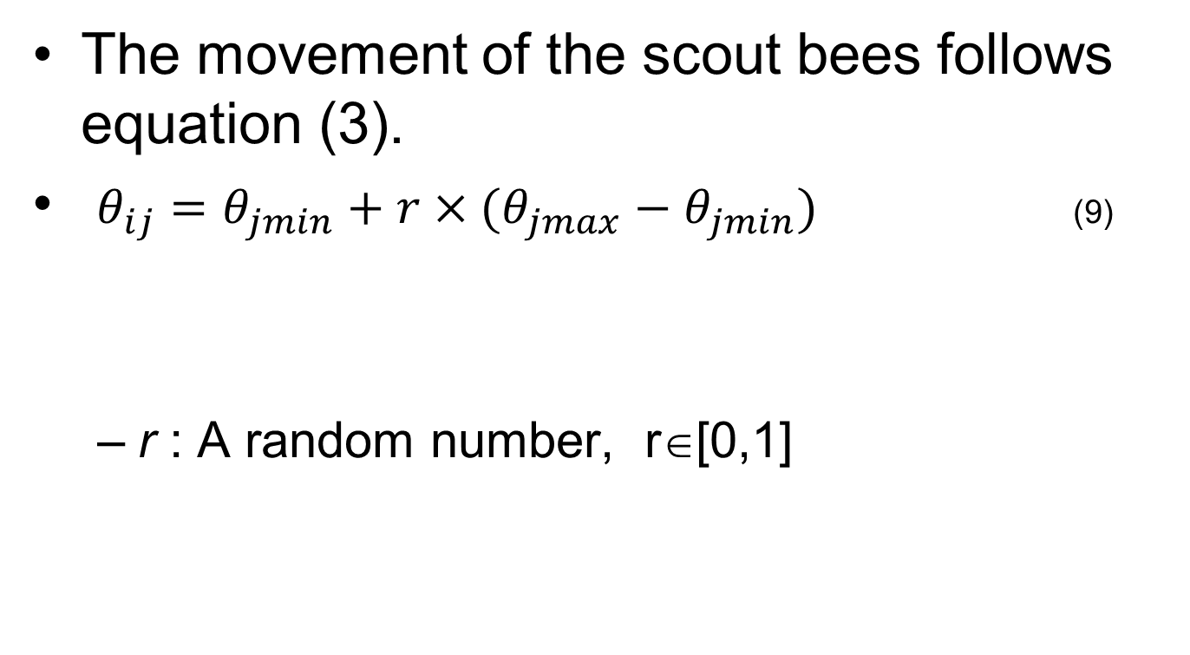
Movement of the Scouts
The movement of the scout bees follows equation (3).
$θ_{ij}=θ_{jmin}+r×(θ_{jmax}−θ_{jmin})$ (9)
r : A random number, r∈[0,1]

Slide 13
5.2 Artificial Bee Colony (ABC) (4)
Record the best solution found so far
The Employed Bee
The Onlooker Bee
The Scout

